Slide 1

6th Grade Accelerated Math
Unit 7, Lesson 7 Finding the Area of Polygons Volume 1, pg. 332

Slide 2


Benchmark
MA.7.GR.1.2
Solve mathematical or real–world problems involving the area of polygons or composite figures by decomposing them into triangles or quadrilaterals.
volume 1, pg. 332

Slide 3
Integrated Mathematical Thinking and Reasoning Standards
MA.K12.MTR.1.1 Actively participate in effortful learning both individually and collectively.
MA.K12.MTR.2.1 Demonstrate understanding by representing problems in multiple ways.
MA.K12.MTR.4.1 Engage in discussions that reflect on the mathematical thinking of self and others.
MA.K12.MTR.5.1 Use patterns and structure to help understand and connect mathematical concepts.
volume 1, pg. 332

Slide 4

Learning Targets
I can decompose a regular polygon into triangles to find the area.
I can decompose a regular polygon into triangles and quadrilaterals to find the area.
volume 1, pg. 332

Slide 5

Warm-Up
volume 1, pg. 332

Slide 6
7.7.1 Warm-Up: Which One?
The dimensions of two rectangles are given.
Rectangle A Rectangle B
13 units by 15 units 2 units by 3 units
1. Explain which rectangle is more like a square.
volume 1, pg. 332

Slide 7

Guided Instruction
volume 1, pg. 333

Slide 8


7.7.2 Guided Instruction: Decomposing Regular Polygons
1. A regular octagon is shown.
On the figure, mark all congruent angles and all congruent sides.
Draw lines to decompose the regular octagon into congruent triangles.
How many congruent triangles did you decompose the regular octagon into?
volume 1, pg. 333

Slide 9
d. Discuss with your partner how decomposing the octagon into congruent triangles is helpful in determining the area.
volume 1, pg. 333

Slide 10
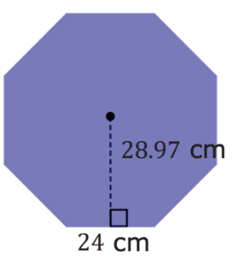
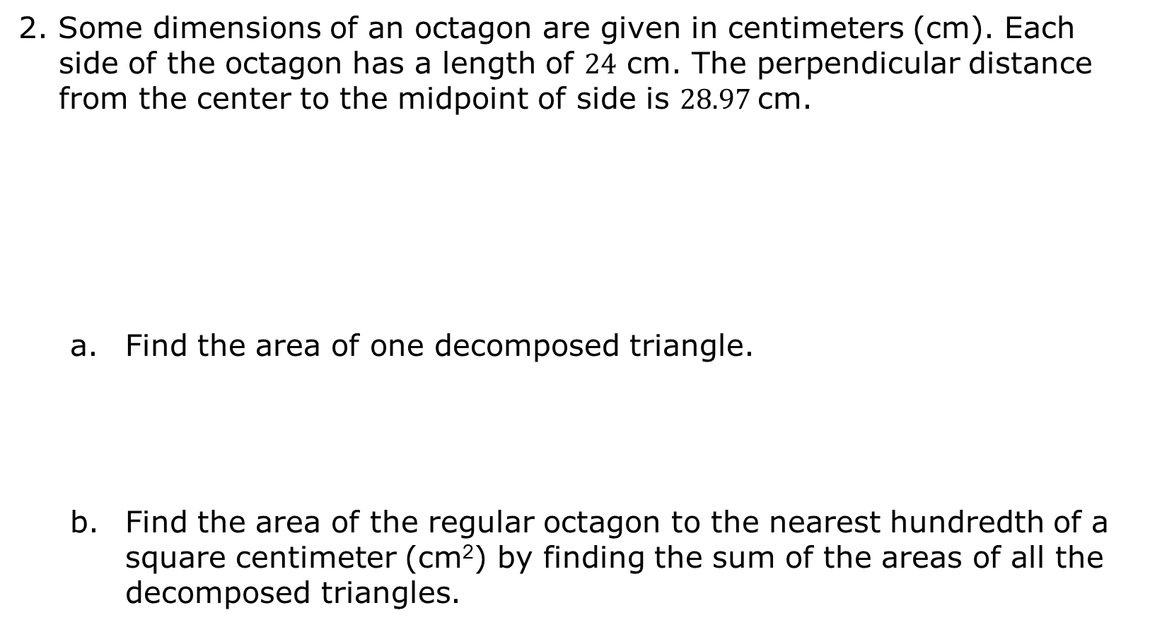
2. Some dimensions of an octagon are given in centimeters (cm). Each side of the octagon has a length of $24$ cm. The perpendicular distance from the center to the midpoint of side is $28.97$cm.
Find the area of one decomposed triangle.
Find the area of the regular octagon to the nearest hundredth of a square centimeter (cm²) by finding the sum of the areas of all the decomposed triangles.
volume 1, pg. 333

Slide 11
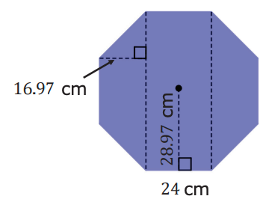
3. An octagon is divided into two trapezoids and a rectangle. Each side of the octagon has a length of 24 cm. The perpendicular distance from the center to the midpoint of a side is 28.97 cm. The height of each trapezoid is 16.97 cm.
Find the area of each decomposed quadrilateral. Round to the nearest hundredth.
Using the decomposed shapes, determine the area of the octagon to the nearest hundredth of a square centimeter (cm²).
volume 1, pg. 334

Slide 12
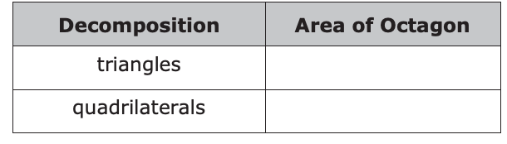
4. Complete the chart using the areas from 2b and 3b.
5. What do you notice about the areas?
volume 1, pg. 334

Slide 13

Collaboration
volume 1, pg. 335

Slide 14


7.7.3 Collaboration: Decomposing Regular Polygons to Find Area
1. Decompose each of the following regular polygons.
volume 1, pg. 335

Slide 15

2. Share with your partner how you decomposed your shapes. If your partner decomposed the shapes differently, draw on the blue shapes how they decomposed their shapes. If you decomposed the shapes in the same way, work together to create a different way to decompose the shapes.
volume 1, pg. 335

Slide 16
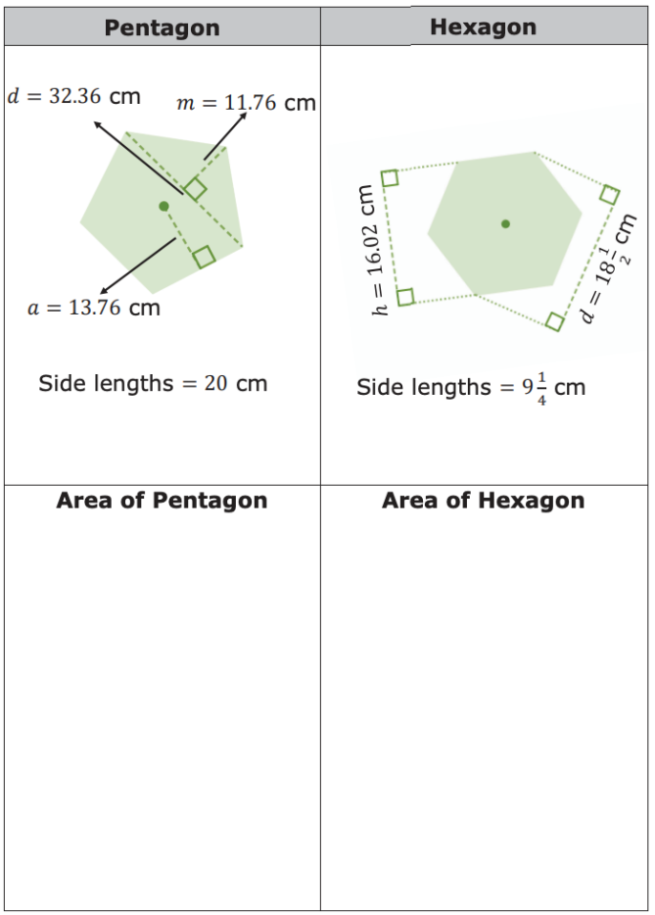
3. The table shows a pentagon and a hexagon. Given measurements in centimeters (cm). Work with your partner to determine the area rounded to the nearest hundredth.
volume 1, pg. 335

Slide 17

Your Turn
volume 1, pg. 336

Slide 18
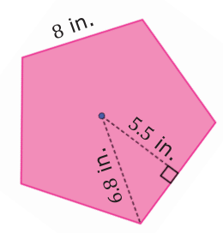
7.7.4 Your Turn!
A regular pentagon is shown with lengths in inches (in.).
What is the area of the pentagon?
volume 1, pg. 336

Slide 19
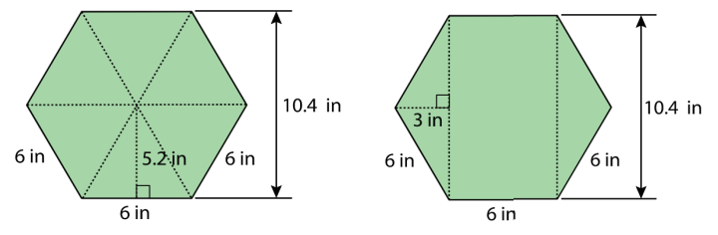
2. Lin and Andre used different methods to find the area of a regular hexagon with 6 in. sides. Lin decomposed the hexagon into six identical, equilateral triangles. Andre decomposed the hexagon into a rectangle and two triangles.
a. Explain why Lin and Andre will find the same area of the hexagon.
volume 1, pg. 336

Slide 20
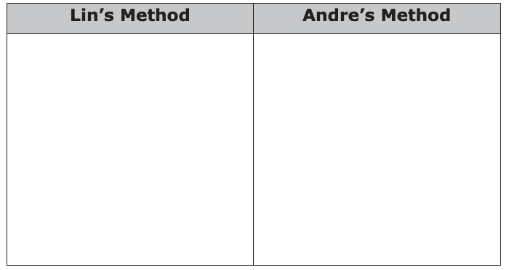
b. Find the area of the hexagon using both Lin’s and Andre’s methods.
volume 1, pg. 336

Slide 21
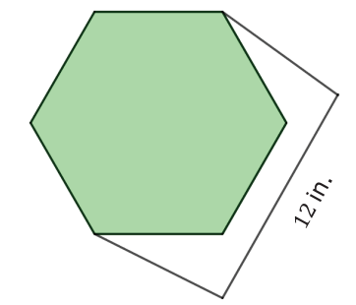
c. Decompose the shape differently than Lin and Andre did.
d. Using the measurements given in all three figures, find the area by finding the sum of your decomposed parts.
volume 1, pg. 337

Slide 22

Wrap-Up
volume 1, pg. 337

Slide 23
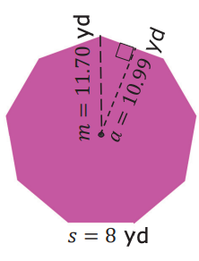
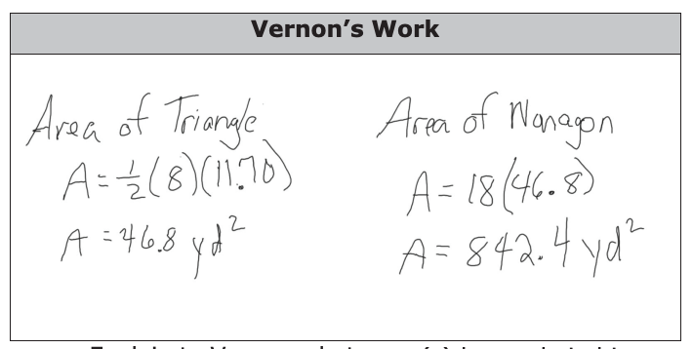
7.7.5 Wrap-Up: Error Analysis
Vernon found the area of the nonagon. His work is shown.
Explain to Vernon what error(s) he made in his work.
What is the area of the nonagon?
volume 1, pg. 337

